Slide 1
Adding and Subtracting Integers

Slide 2

Review
What are integers?
Positive and Negative whole numbers
Negative
Positive

Slide 3
Which number is greater?
- 1 and 0
2 and -4
- 20 and -25

Slide 4


24
7
30
Date
Adding and Subtracting Integers
EQ – How do we add and subtract integers?
Subtraction
Addition
Which direction do we go?
Subtraction we go left!
Addition we go right!
Positive integers
5 + 2
5 - 2
Start at 5 and go to the right 2
Get to 7
Start at 5 and go to the left 2
Get to 3
Notes:
Ask student to write questions for the notes.
Model Chunking of notes.

Slide 5
24
7
30
Date
Adding and Subtracting Integers
EQ – How do we add and subtract integers?
Subtraction
Addition
Think of negative numbers as the same as subtracting the number
What about adding negative numbers?
5 + -2
-2 + -2
Start at 5 and go to the left 2
Get to 3!
Start at -2 and go to the left 2
Get to -4!
Notes:
Ask student to write questions for the notes.
Model Chunking of notes.

Slide 6
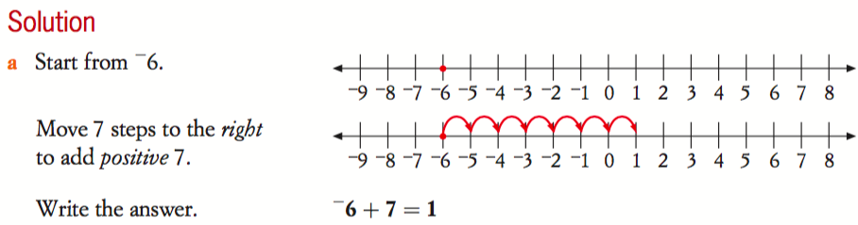
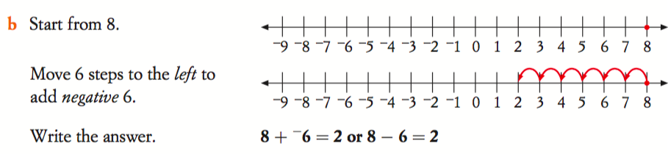
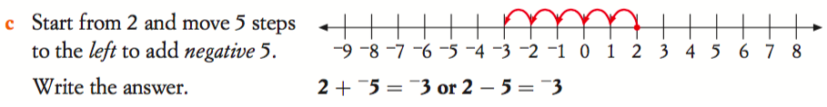

Slide 7
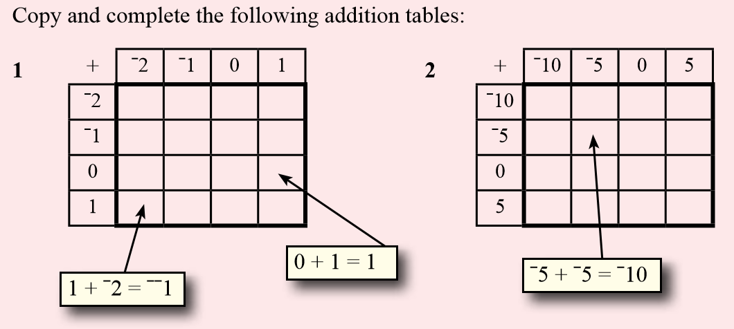
Task Side Practice (use your number line!)

Slide 8
24
7
30
Date
Adding and Subtracting Integers
EQ – How do we add and subtract integers?
Subtraction
Addition
Two negatives become a positive!
Think of negative numbers as the same as subtracting the number
What about subtracting with negative numbers?
-3 - 2
-4 - -2
Start at -3 and go to the left 2
Get to -5!
Start at -4 and go to the right 2
Get to -2!
Notes:
Ask student to write questions for the notes.
Model Chunking of notes.

Slide 9
https://www.youtube.com/watch?v=DBSviXhkubg

Slide 10
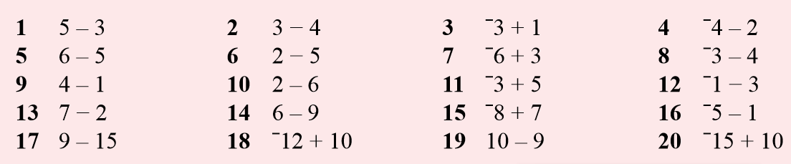
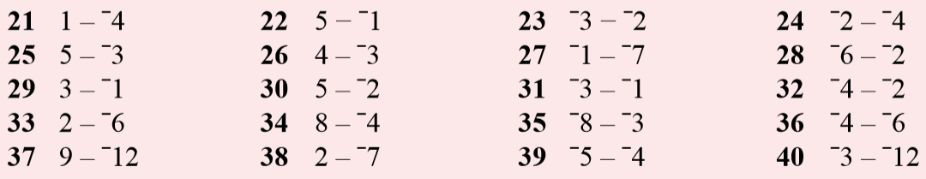
Beginner – pick 4 from each section
Intermediate – pick 8 from each
Advanced – do all of them!
Task Side Practice (use your number line!)

Slide 11
Homework – Freefall Worksheet
Adding and Subtracting Integers

